Slide 1
Data Structures
Lecture 9
Hashing
Prantik Paul [PNP]
Lecturer
Department of Computer Science and Engineering
BRAC University

Slide 2
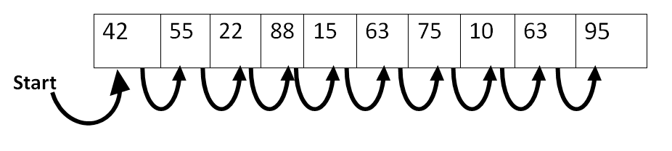
Linear Search
Problem?

Slide 3
Linear Insert/Delete
Problem?

Slide 4
Linear Search
What if it’s Binary Search?
On a sorted array?

Slide 5
Linear Insert/Delete
What if it’s on a sorted array?

Slide 6
Search/Insert/Delete
What if it’s on a Linked List?

Slide 7
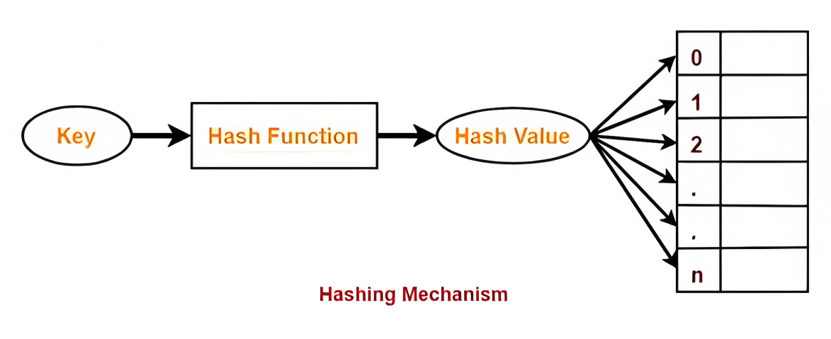
Solution? - Hashing
Search?
Insertion?
Deletion?

Slide 8
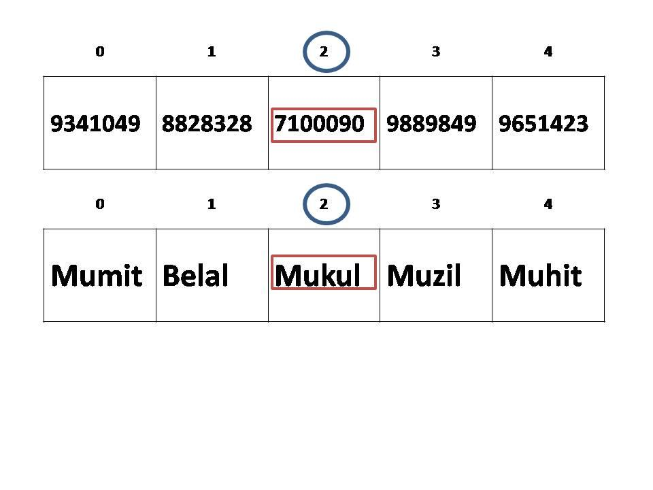
Key-Value Pairs

Slide 9
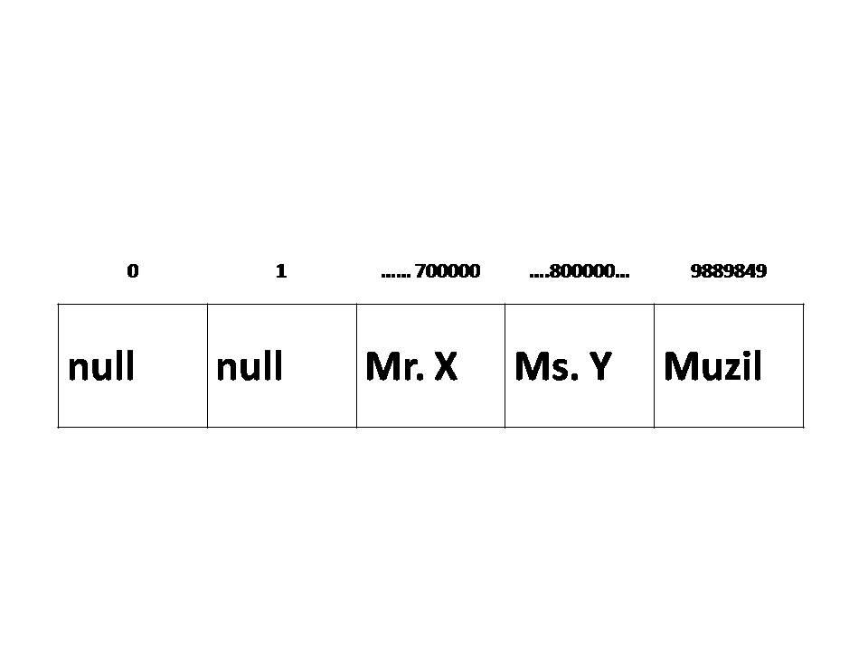
Key-Value Pairs

Slide 10
Hashing
name
Karen
name
key
value
(110 + 97 + 109 + 101) = 417 % 5 = 2
Hash Function
 |  | name
 |  | Karen

Slide 11
Hashing
COLLISION!!
mean
3
mean
key
value
(109+101+97+110) = 417 % 5 = 2
 |  | name
 |  | Karen

Slide 12
Hashing
 |  | name
 |  | Karen
mean
3

Slide 13
Hashing
 |  | mean
 |  | 3
name
Karen
mane
no
Forward Chaining

Slide 14
Hashing
 |  | mane
 |  | no
mean
3
name
Karen
Forward Chaining

Slide 15
Hashing
 |  | mane
 |  | no
mean
3
name
Karen
Worst Case?
Search/Insert/Delete?

Slide 16
Forward Chaining
How big should the array be?

Slide 17
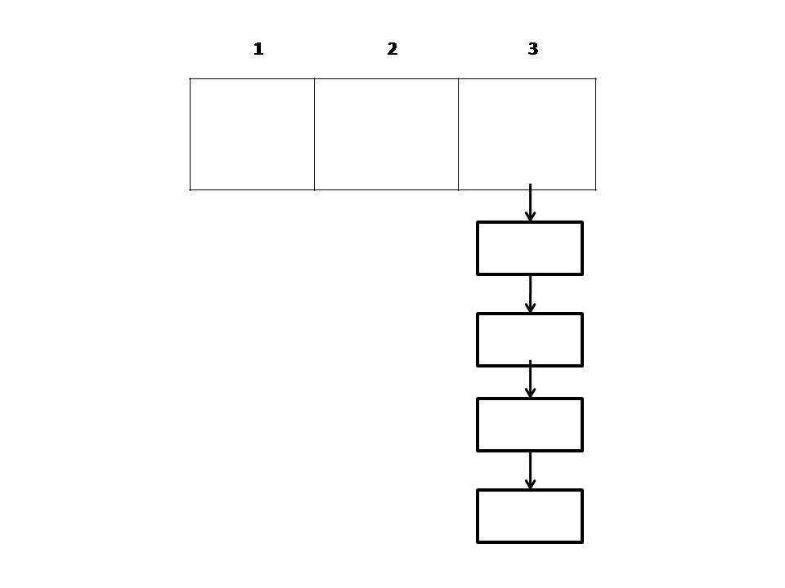
Forward Chaining
Too small

Slide 18
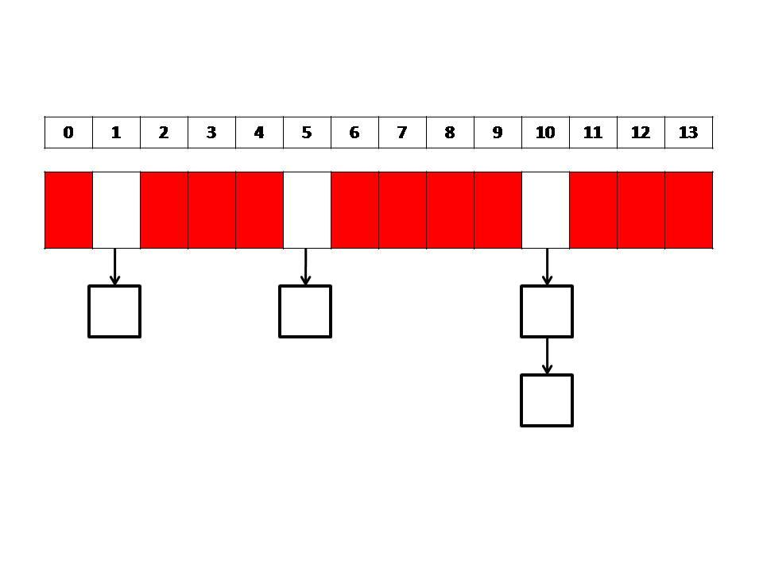
Forward Chaining
Too big

Slide 19
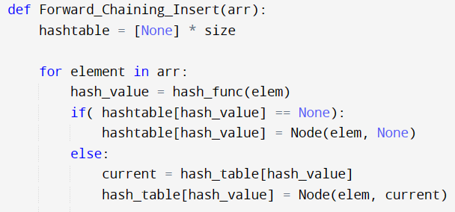
Forward Chaining (Insert)

Slide 20
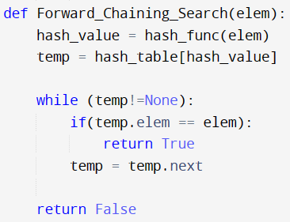
Forward Chaining (Search)

Slide 21
Forward Chaining (Delete)
Do It Yourself

Slide 22
Forward Chaining
hash(key) = key % 5
Insert (Key: 12 Value: "Apple")
Insert (Key: 5 Value: "Orange")
Insert (Key: 17 Value: "Banana")
Insert (Key: 10 Value: "Grapes")
Insert (Key: 22 Value: "Watermelon")
Insert (Key: 15 Value: "Pineapple")

Slide 23
Hashing
 |  | name | mean
 |  | Karen | 3
Linear
Probing

Slide 24
Hashing
 |  | name |  | mean
 |  | Karen |  | 3
hash1(mean) = 2
hash2(mean) = 7
Double Hashing
Location = (2 + i x 7)%5

